Slide 1

Education ATAR vs Geolocation
GROUP 6
Josh Martin
Peregrin Ryan
Udeshi Pereira

Slide 2


Motivation:
Our group was interested in investigating the relationship between Geolocation access to education as well as the effect of School sector (Private and Public) has on education academic success.

Slide 3

Students that are within major cities such as Melbourne or Geelong, that also receive Private, non-government education are more likely to have higher academic performance within Victoria
Hypothesis:
This Photo by Unknown Author is licensed under CC BY-NC

Slide 4

The way we measure academic success was measuring ATAR Score

Slide 5

Notes:
From my notes

Slide 6


Slide 7
QUESTIONS
Is there a relationship with Geolocation academic success?
Is there a relationship with Geolocation and the choices of schools?
Which school sector has their best academic success?

Slide 8

Data cleaning process
Josh Martin

Slide 9
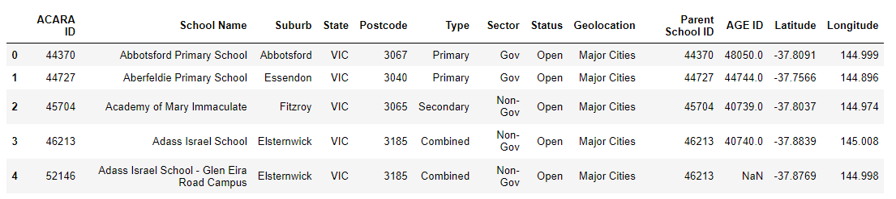
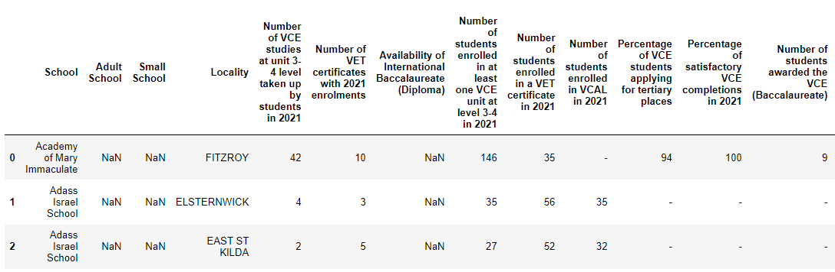
RAW Data
ASL website
VCAA website

Slide 10
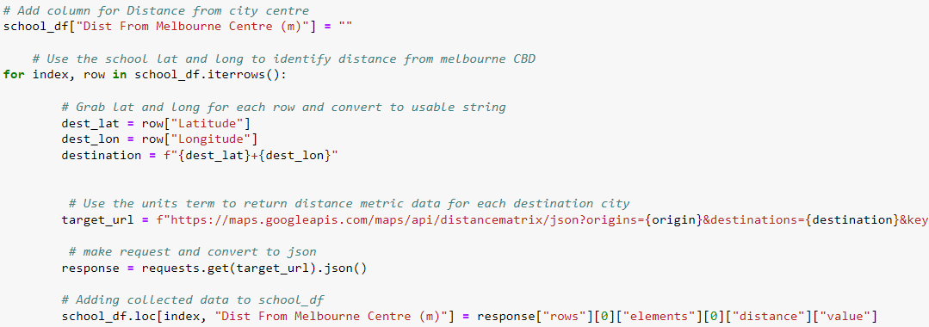
RAW Data
VCAA website
Distance for each school from a static location

Slide 11
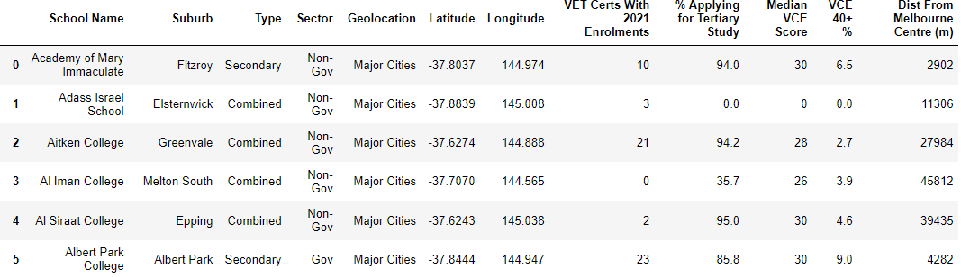
RAW Data
VCAA website
Clean Data Ready For Analysis

Slide 12
DATA Analysis
PEREGRIN RYAN

Slide 13
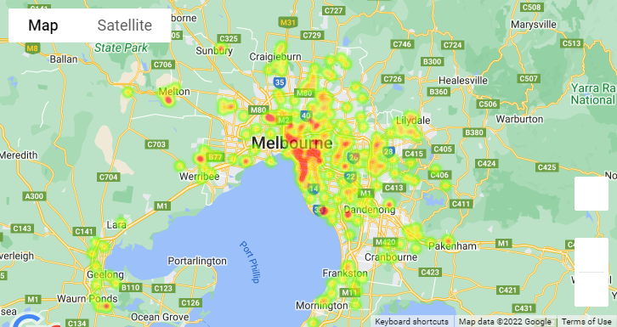
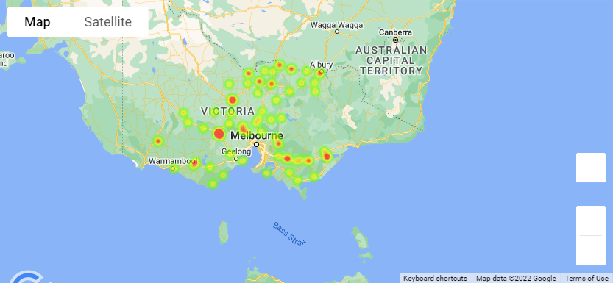
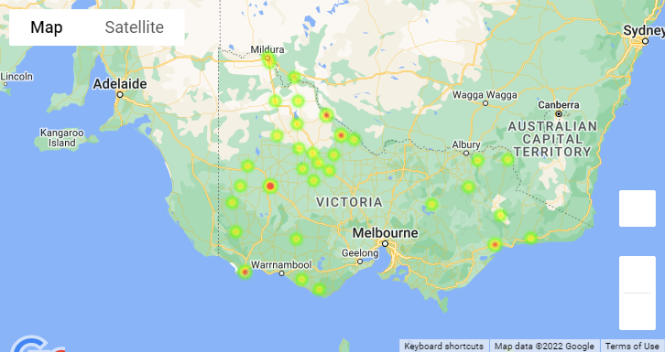
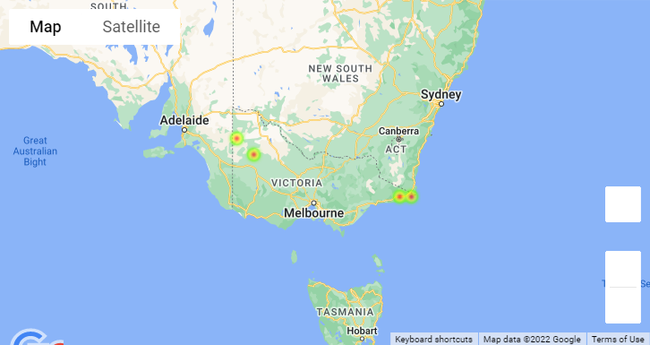
Defining Geolocation
Major cities – Schools within Melbourne and Geelong
Inner regional – Schools within towns and cities with larger populations (Bendigo, Ararat)
Outer regional – Schools within towns with a lower population (Horsham, Mildura)
Remote – Schools within smaller less connected towns (Murrayville, Rainbow)
Major Cities
Inner Regional
Outer Regional
Remote

Slide 14
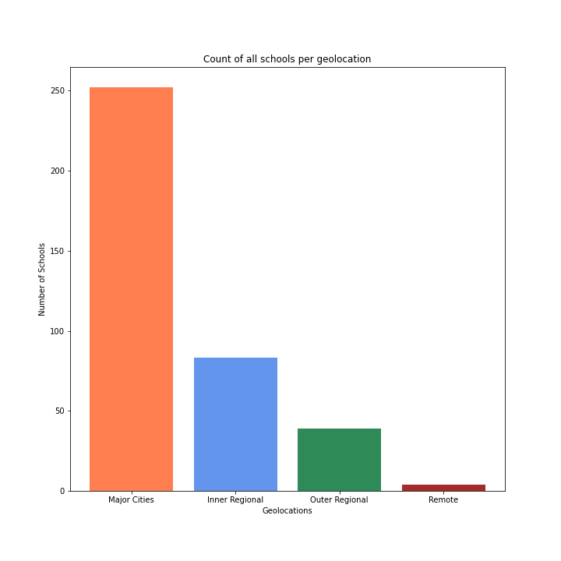
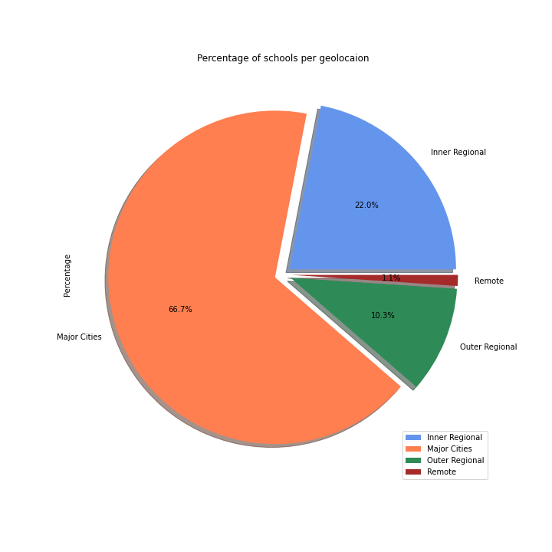
How Many Schools within Each Geolocation

Slide 15
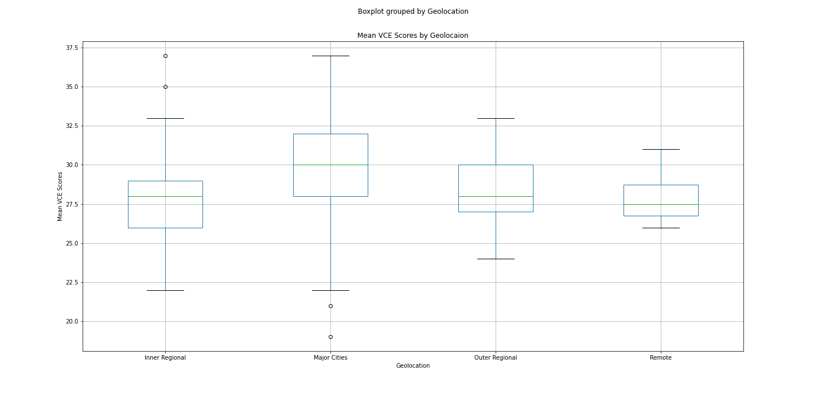
Mean VCE scores by geolocation

Slide 16
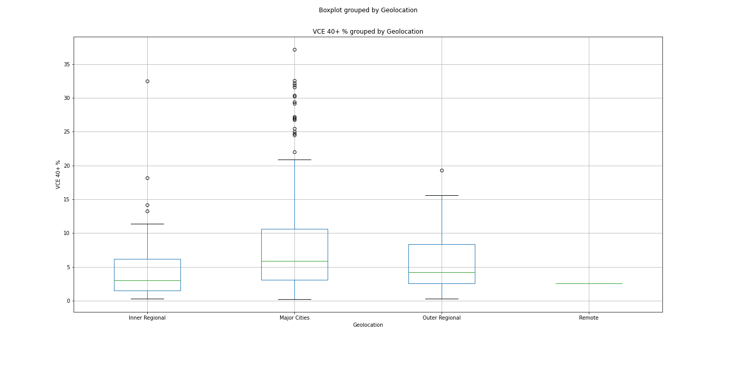
Percent over 40% VCE results by geolocation

Slide 17
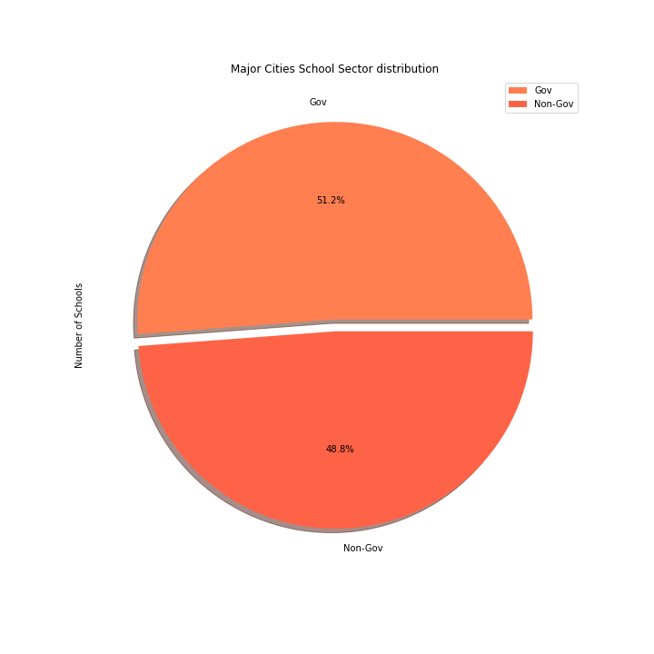
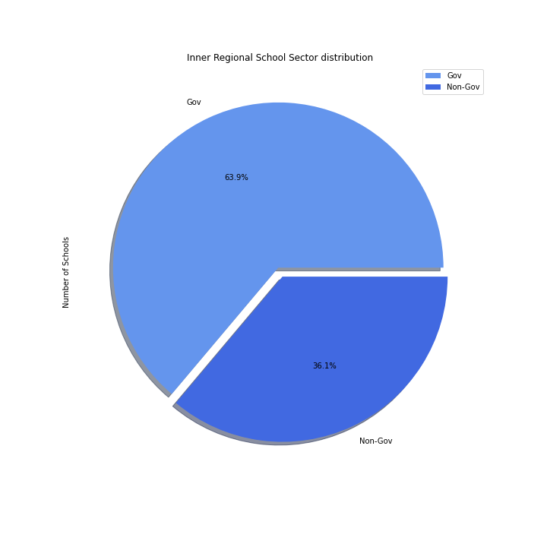
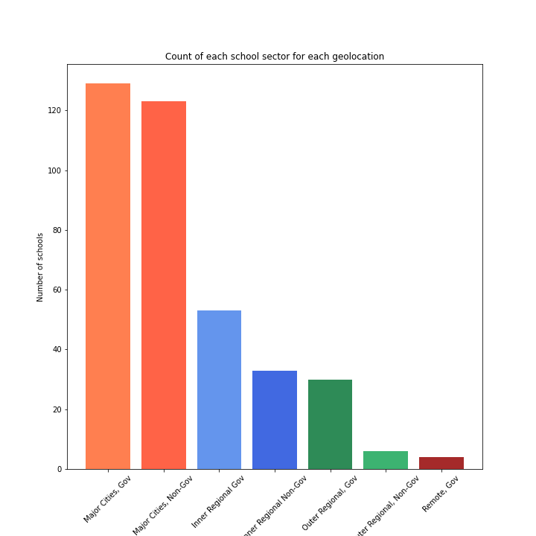
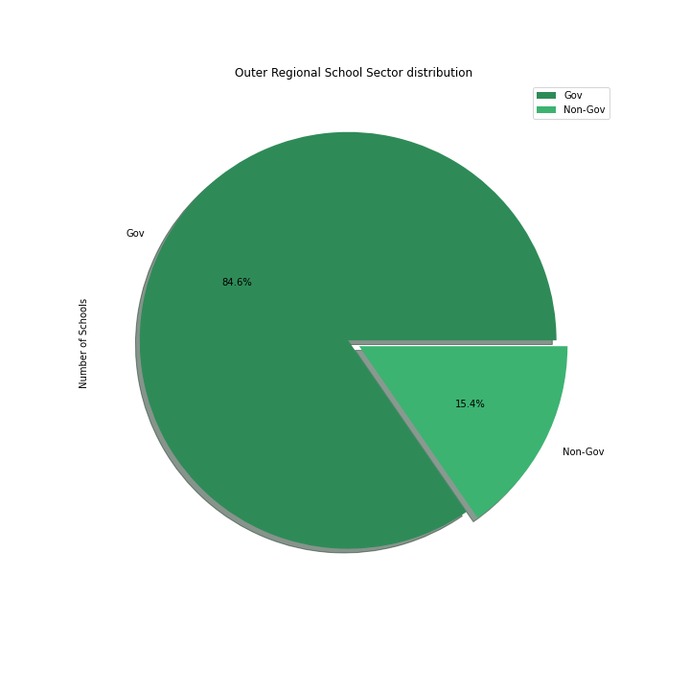
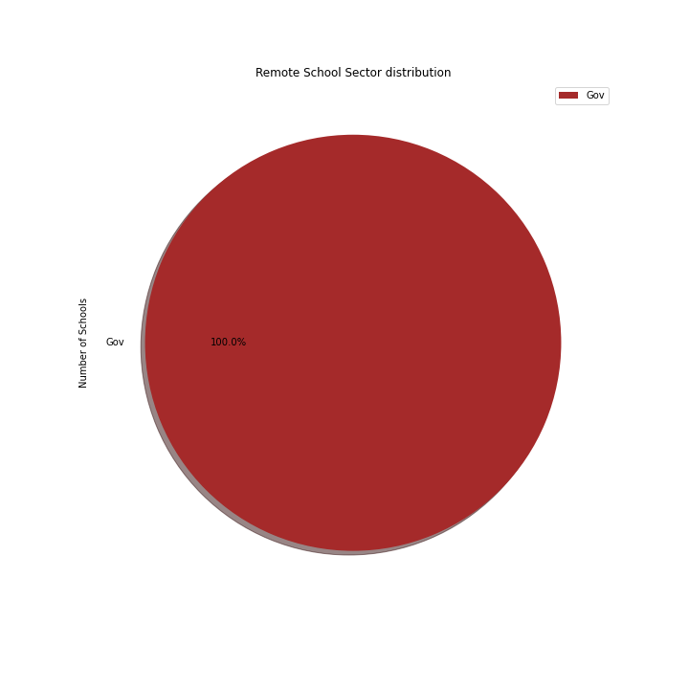
School Sectors Within Each Geolocation

Slide 18
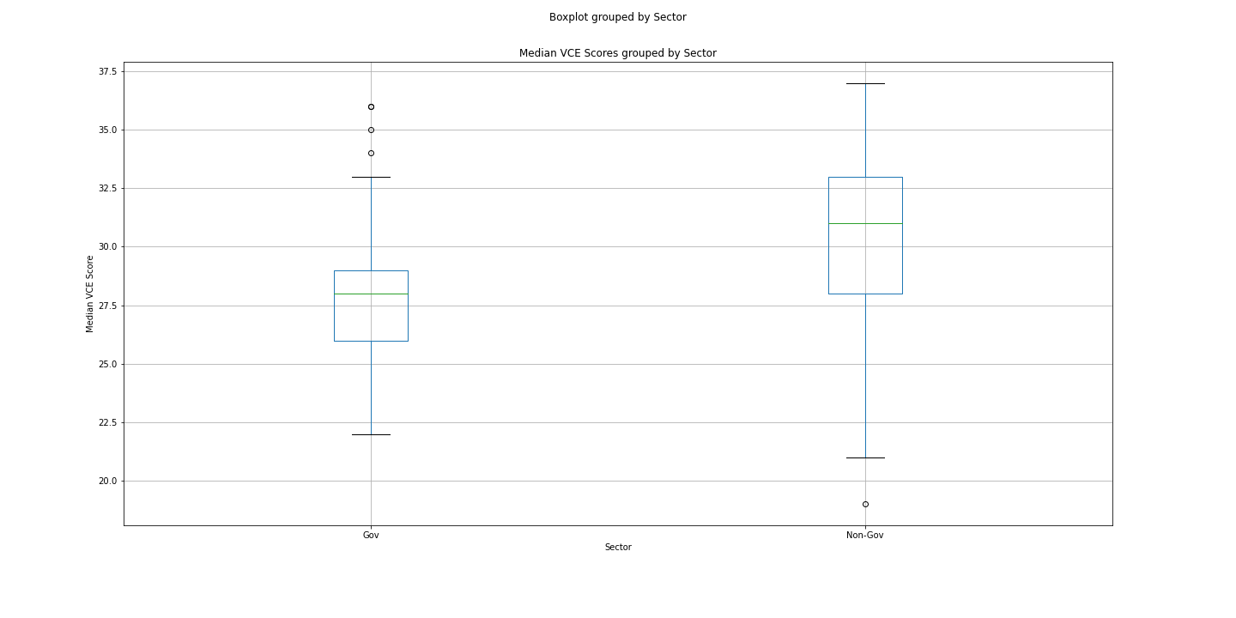
Median VCE score by sector

Slide 19
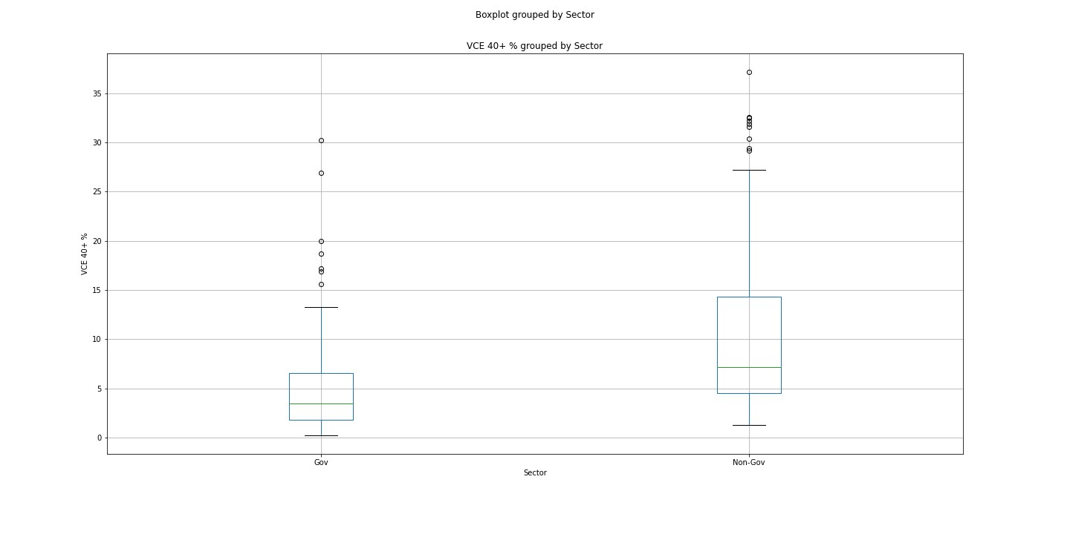
Percent over 40% VCE results by sector

Slide 20


Slide 21
ANSWERS
Is there a relationship with Geolocation academic success?
No, No geolocation performs significantly better than any other geolocation.
Is there a relationship with Geolocation and the choices of schools?
Yes, major cities have a significantly higher number of schools both government and non-government. Meaning major cities have the highest amount of choice for schools.
Which school sector has their best academic success?
Non-government schools have the best chances of success, and on average perform better than government schools but are less consistent compared to government schools.

Slide 22

Conclusion

Slide 23

Conclusion
After collecting processing and analysing the data we can confirm our hypothesis that in fact students within the Major Cities also receive Non-Gov education are more likely to have higher average academic performance.

Slide 24
Data Sources: https://asl.acara.edu.au/about-asl - https://bettereducation.com.au/results/VCE_ATAR.aspx -

Slide 25

Group 6
Josh Martin
Peregrin Ryan
Udeshi Pereira

